Slide 1
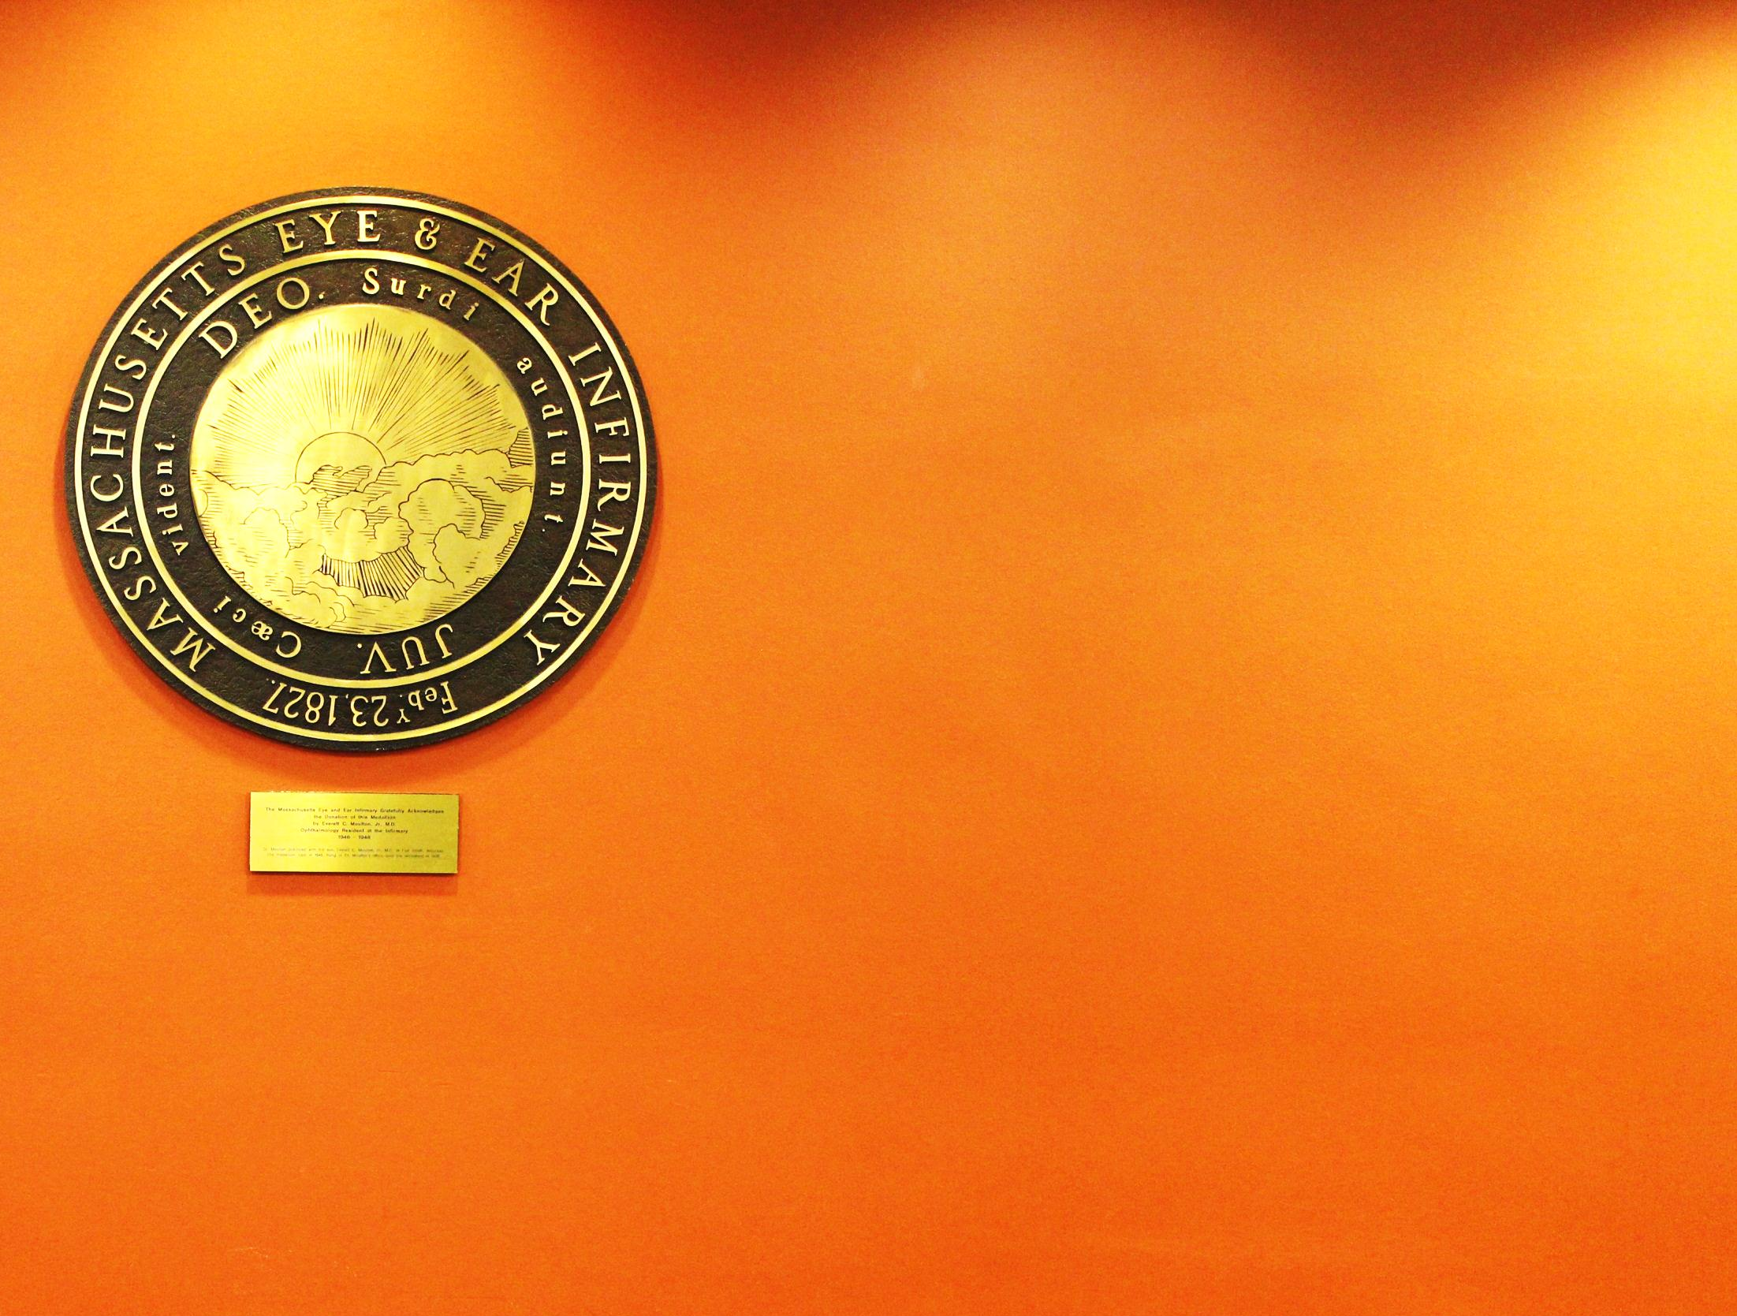
Sophal HENG, MD
Khmer-Soviet Friendship Hospital
Dr KONG Piseth Eye Hospital
jointly with Dr Agarwal’s Eye Hospital
Notes:
PRK > McDonald > first sighted human eye in 1988
LASIK > Pallikaris > Until the late 1990s
more than 95% of patients achieve at least 20/40 or better vision after LASIK.
four to 10 percent of patients may require enhancement (retreatment for under-correction.)
Cornea average = 520um
Flap 130-160um
depth of the excimer laser ablation on average must not exceed 45 to 120 microns
with 325 (conservative case) to 250 microns , left in the stromal bed
250 micron limit to the residual stromal bed following LASIK < FDA

Slide 2

Screening Patient for
LASER Vision Correction
Sophal HENG, MD
Khmer-Soviet Friendship Hospital
Dr KONG Piseth Eye Hospital
joinly with Dr Agarwal’s Eye Hospital

Slide 3
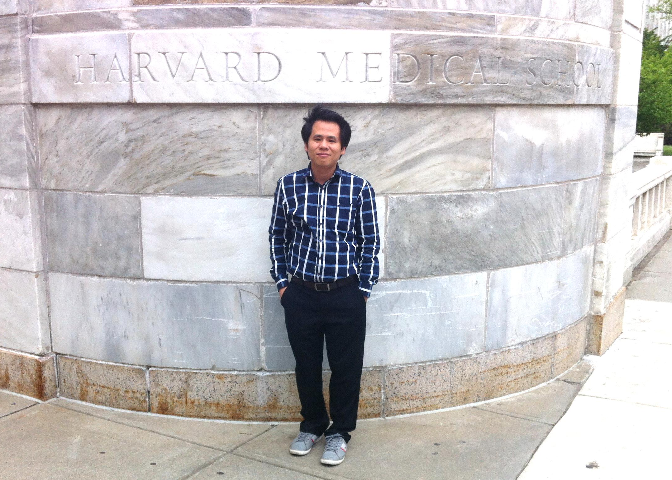

Slide 4
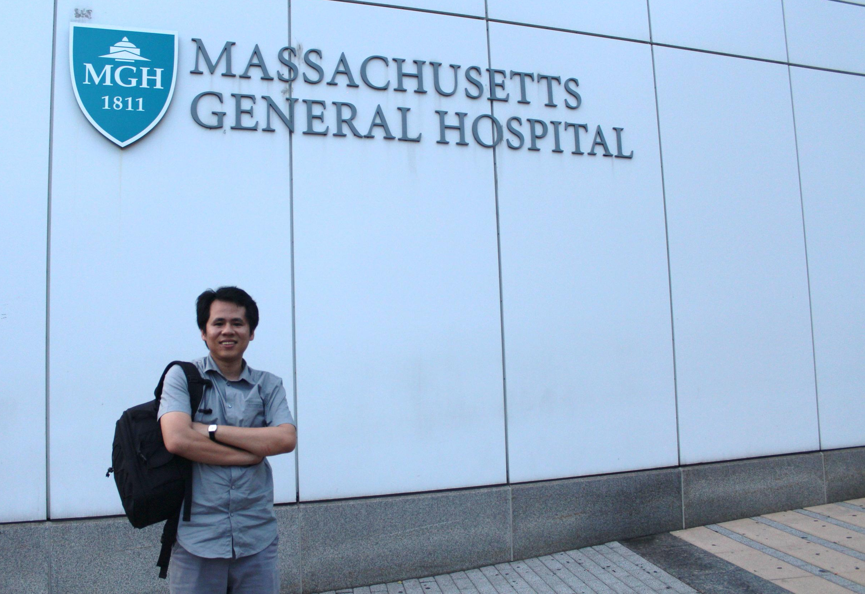

Slide 5
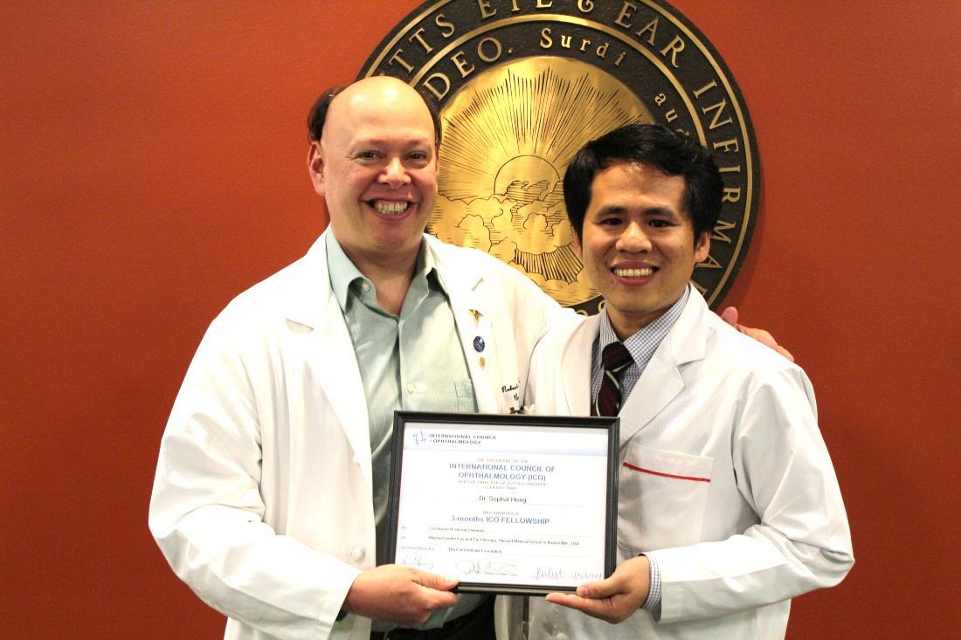
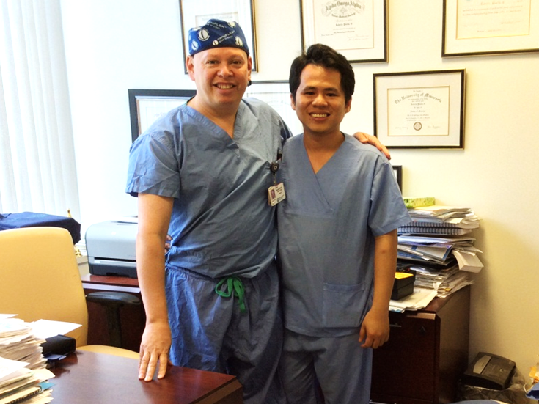
International Council of Ophthalmology (ICO)
3-Months Fellowship
In Cornea and External Disease
At Mass Eye and Ear Infirmary, Harvard Medical School, Boston, MA, USA
With Dr. Robeto Penida II
Chef Department
Corneal and Refractive Surgery

Slide 6
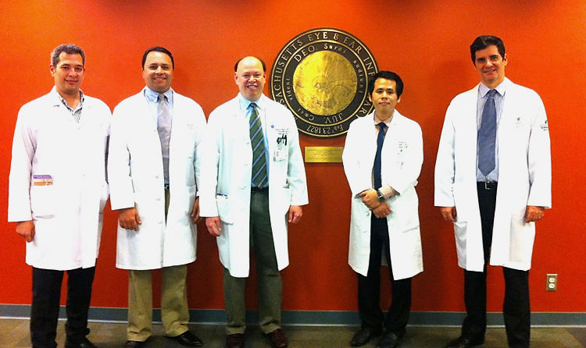
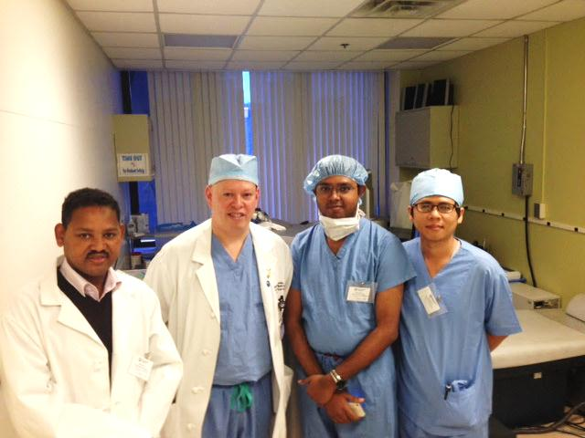
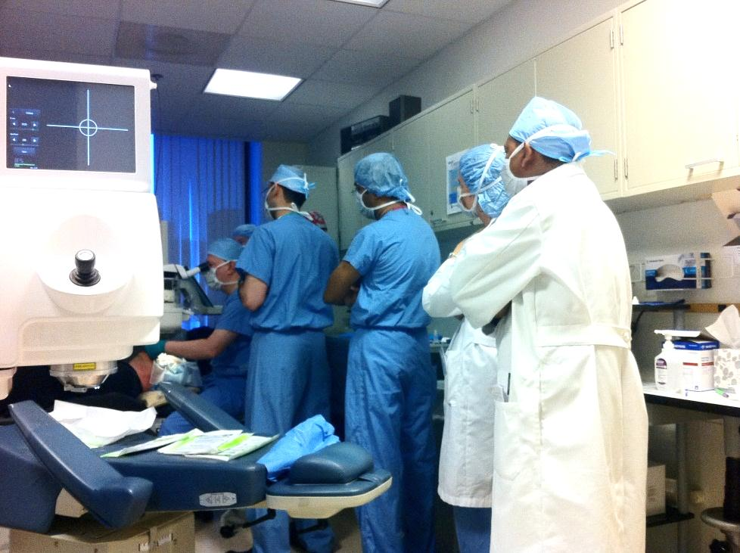
American Society of Cataract Refractive Surgery
(ACSRS 2014, Boston city MA USA)
Many visiting doctor from many country as Egypt, Brazil, Span, Ethiopia, India, Taiwan , China…

Slide 7
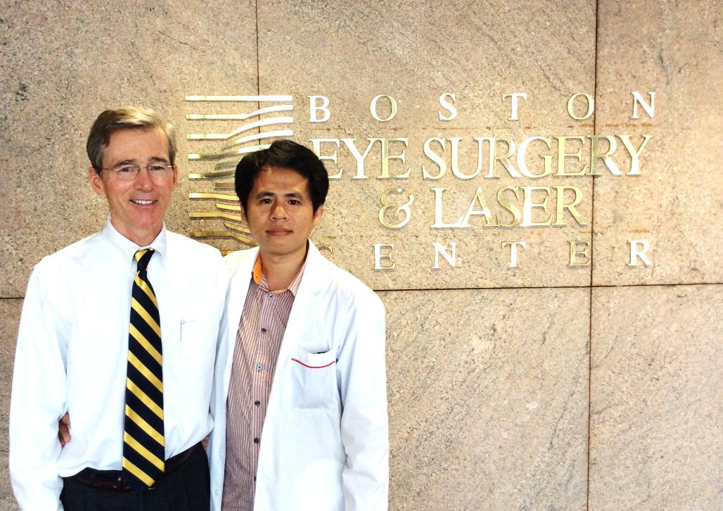
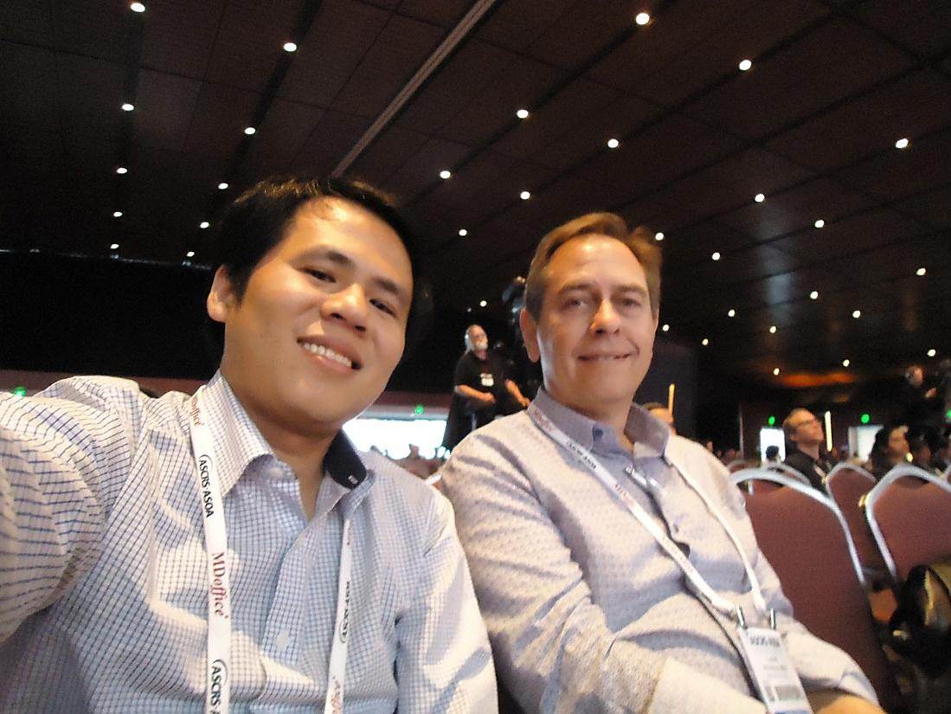
Meeting some lecturer
that I know them in Cambodia.
Michael G Morley, MD
Retina and Vitreous Diseases
At Ophthalmic Consultant of Boston(OCB),
Boston MA USA
Laurence Sullivan, MD
Cornea and Refractive Surgery,
At Bayside eye specialists, Australia

Slide 8
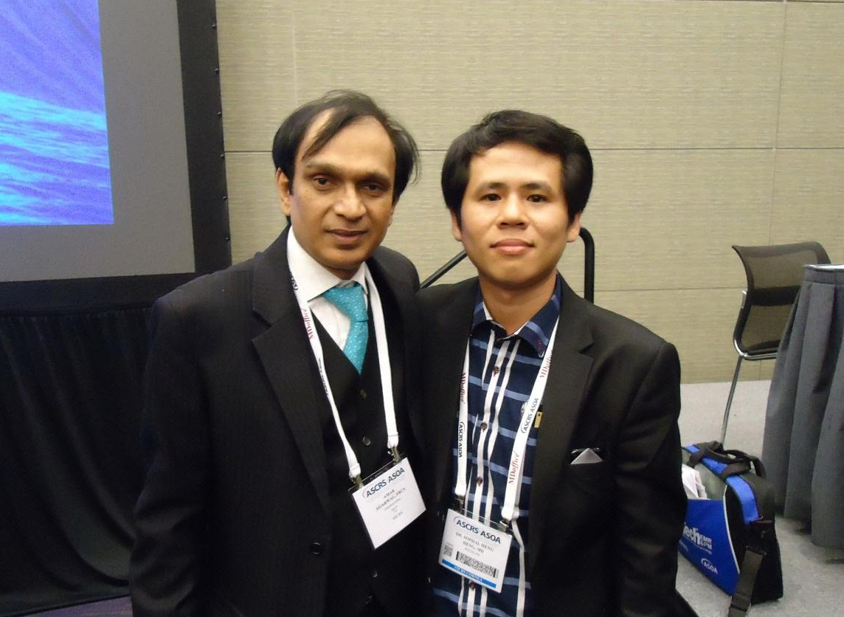
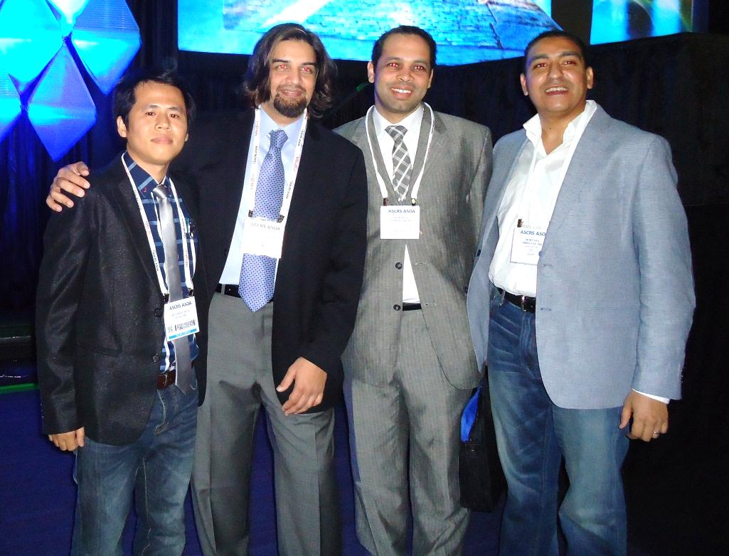
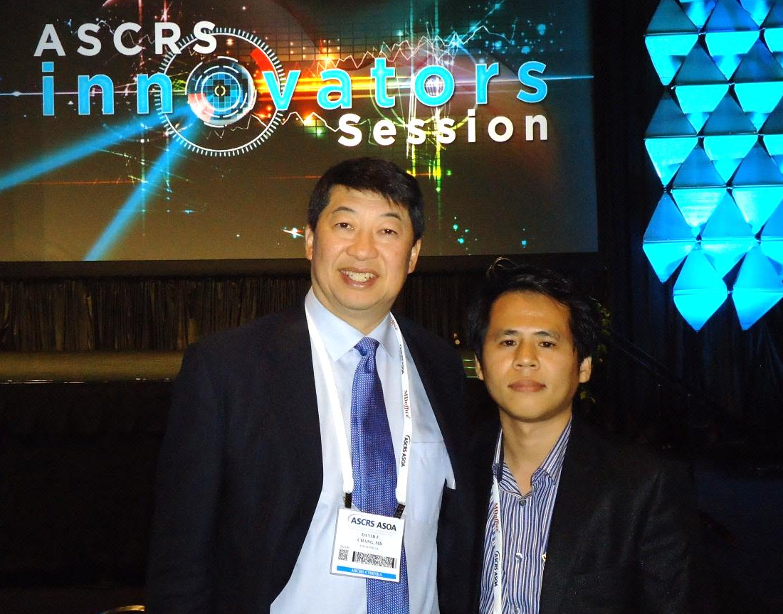

Slide 9
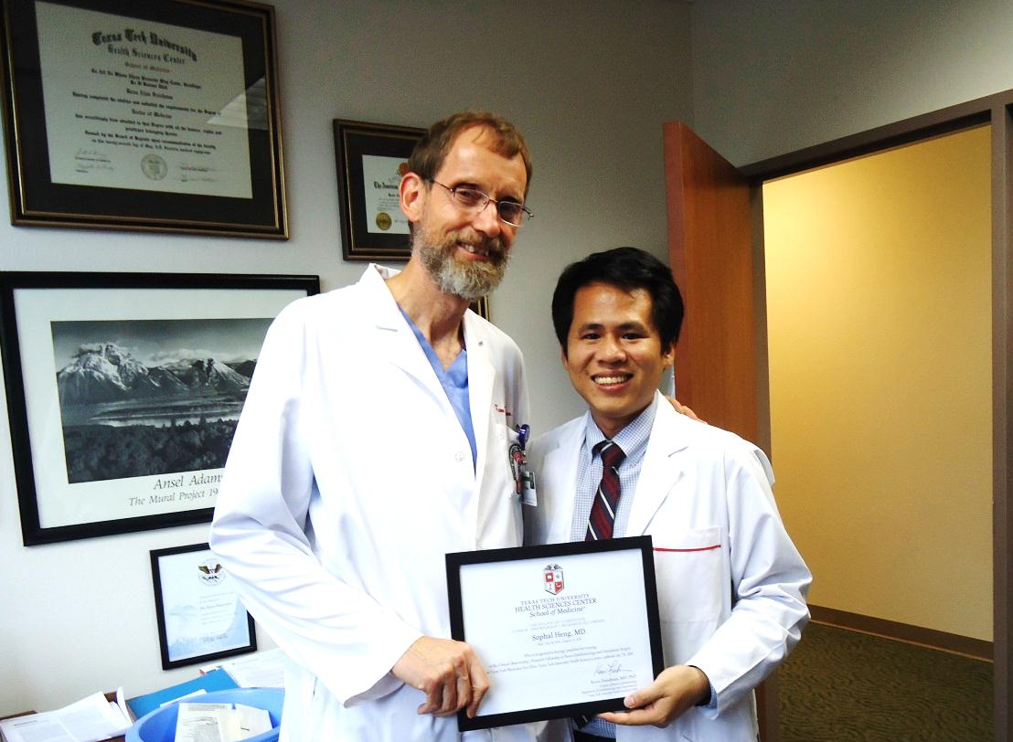
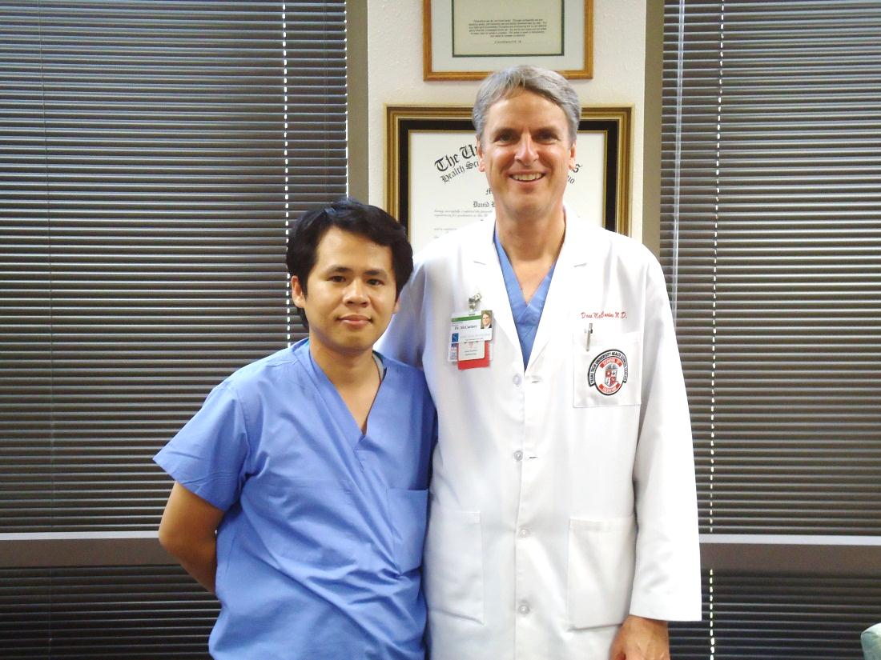
Meeting some lecturer
that I know them in Cambodia.
Kenn Freedman, MD
Neuro-ophthalmology and oculoplasty
At Texas Tech University of Health Science Center (TTUHSC), Lubbuck TX USA
Prof. Davit McCartney
Cornea and Refractive Surgery
Chef Department of Ophthalmology
At TTUHSC, Lubbuck TX USA

Slide 10
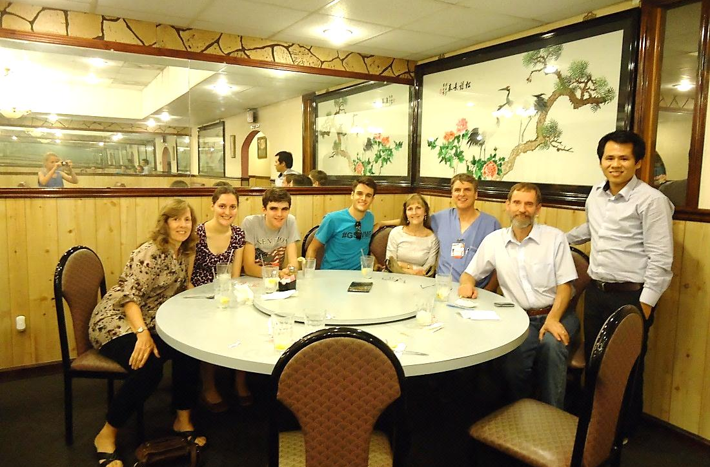

Slide 11
Screening Patient for
LASER Vision Correction
Sophal HENG, MD
Khmer-Soviet Friendship Hospital
Dr KONG Piseth Eye Hospital
jointly with Dr Agarwal’s Eye Hospital
Notes:
more than 95% of patients achieve at least 20/40 or better vision after LASIK.
four to 10 percent of patients may require enhancement (retreatment for under-correction.)
Cornea average = 520um
Flap 130-160um
depth of the excimer laser ablation on average must not exceed 45 to 120 microns
with 325 (conservative case) to 250 microns , left in the stromal bed
250 micron limit to the residual stromal bed following LASIK < FDA

Slide 12
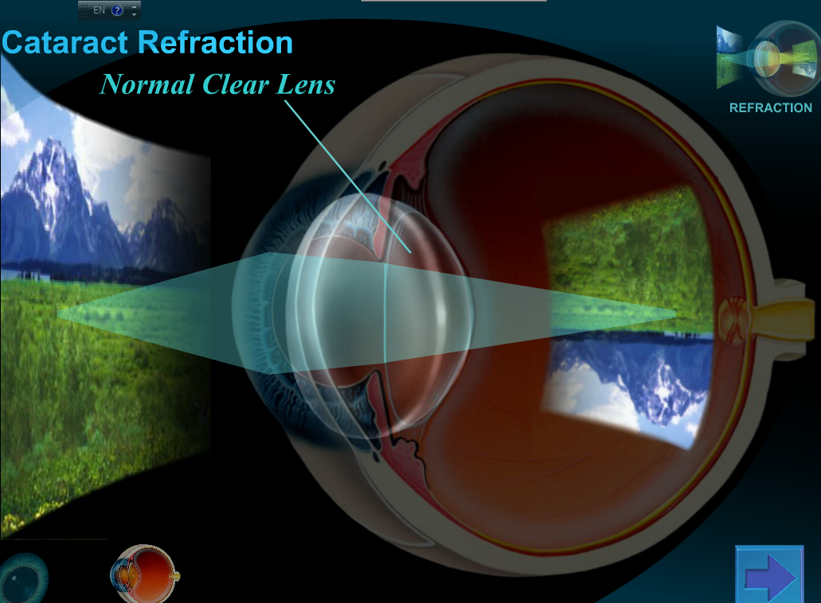
Refractive Power of The Eye
Because of this, it make my eye see better…
Lens’s Power Refractions
§ + 22D
Cornea’s Power Refractions
§ +45D
Ocutouch ®

Slide 13
LENS Refractive Surgery
/ Cataract Surgery
Couching
ICCE : intra capsular cataract extraction
ECCE : extra capsular cataract extraction
PHACOemulsification
SICS : small incision cataract surgery

Slide 14
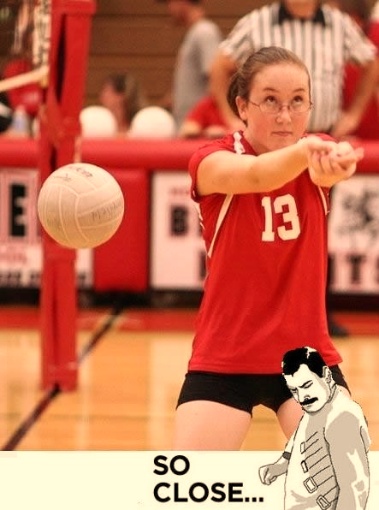
Corneal
Refractive Surgery

Slide 15
Corneal Refractive Surgery
I- Incisional Refractive Technique
Radial Keratotomy [RK] | Astigmatic Keratotomy [AK / LRI] | Hexagonal Keratotomy [HexK]
II- Laser Refractive Corneal Procedures
Photo Refractive Keratectomy [PRK]
LASer In Situ Keratomileusis [LASIK]
LASer sub Epithelial Keratomileusis [LASEK]
Epithelial LASer In Situ Keratomileusis [Epi-LASIK]
Refractive Lenticular Extractions [ReLEx]
III- Miscellaneous
Laser Thermal Keratoplasty [LTK] | Conductive Keratoplasty [CK] | OrthoKeratology [OK] | INTrasromal Corneal ring Segment [INTACS] | Intracorneal Intays

Slide 16
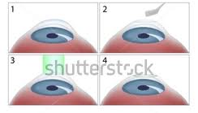
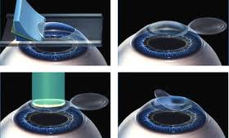
Photo Refractive Keratectomy [PRK]
LASer In Situ Keratomileusis [LASIK]

Slide 17
Basic for Screening Pt
Age : 18 to 40 yrs
Glasses ( stable refraction 1yrs < 0.5o D)
  Myopic -1.5o D to -10.oo D
  Hyperopic +1.oo D to +5.oo D
  Astigmatism -0.5o D to -4.5o D
Role out : Glaucoma, Retina disease,
Cataract, Uvietis and Corneal disease
Role out : Some systemic disease,
pregnancy and lactation

Slide 18
Careful with Pt…
Schirmer is less
Soft / Hard Contact lens wear
Viral keratitis
Glaucoma
Uveitis
Retina disease
Corneal dystrophy or cornea ecstasias

Slide 19
Careful with Pt…
Vascular Diseases
( Malignant hypertension, Uncontrolled diabetes mellitus , Clotting or other blood disorders )
Collagen Vascular Diseases
(Systemic lupus erythematous, Rheumatoid arthritis, Scleroderma, Fibromyalgia)
Inflammation Diseases
(Multiple sclerosis, Hyperthyroidism)

Slide 20
Careful with Pt…
Some medication : Isotretinoin , Sumatriptin , anti-rheumatic drug, anti-coagulants drug, Steroids drug, or Immuno-suppressant drug…
Pregnancy and lactation
Known medication allergy ???
Known allergy to food, metals, or others ???

Slide 21
Investigation
Power Refraction
Corneal Topography( ORBscan / Pentacam)
K reading ( K < 40 or K > 46 ) ➔ PRK
Pachymetry (Corneal Thickness and RSB)
Notes:
Zyoptix
90um flap vs 130um flap
PRK is not advise Power <1.50 D or > 6.00 D

Slide 22
1- Power Refraction
Refraction
UCVA | Distance
 | Near
 | Sph | Cyl | Axis | BCVA
Old Glasses
Manifest Refra.
Cyclo. Refra.
Pupil Size | mm
Photopic
Scotopic
Dominant Eye
RE
LE
Notes:
ablation zone diameter should larger than the scotopic pupil diameter

Slide 23
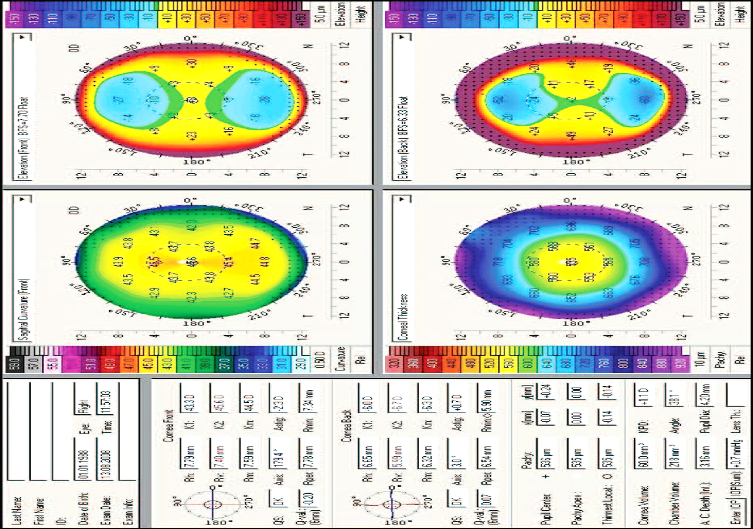
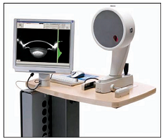
2 - Corneal Topography
Notes:
Sagittal curvature front
- Symmetric bow-tie maybe indicative of normal astigmatism/very rarely a symmetrical type of keratoconus.
Smiling face is certainly risky because it often leads to post operative ectasia, and might be an indicator of keratoconous.
Junctional – is a subject of suspicion.
Vortex – is indicator of corneal instability and it may precede keratoconous. ( notice the vortex distribution of the red and blue line)

Slide 24
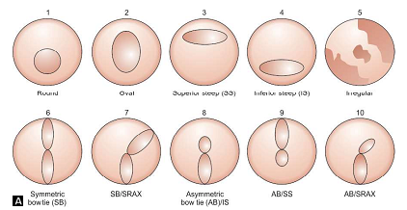
Tomographic Shape Patterns Characterizing Irregularity
Notes:
Sagittal curvature front
- Symmetric bow-tie maybe indicative of normal astigmatism/very rarely a symmetrical type of keratoconus.
Smiling face is certainly risky because it often leads to post operative ectasia, and might be an indicator of keratoconous.
Junctional – is a subject of suspicion.
Vortex – is indicator of corneal instability and it may precede keratoconous. ( notice the vortex distribution of the red and blue line)

Slide 25
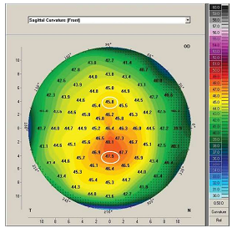
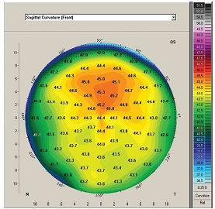
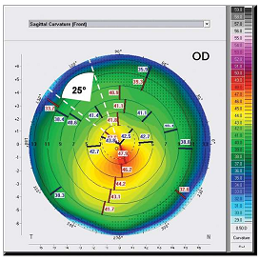
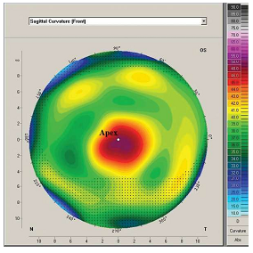
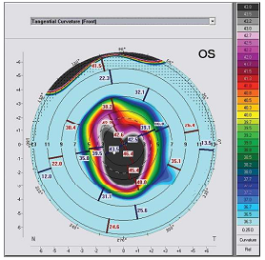
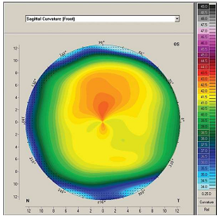
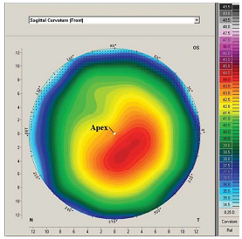
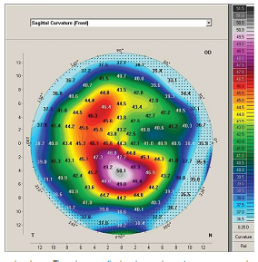
Tomographic Shape Patterns Characterizing Irregularity

Slide 26
3 – Post-op K-reading
( K < 40 or K > 46 )➔ PRK
Myopia
flattest K – ( 0.75D x Power )
not less than < 34 D
Hyperopia / Presbyopia
steepest K + (1.ooD x Power)
not more than > 48 D
Quality of vision in
spherical aberrations
Notes:
Myopia > post-op very flat cornea > OBLATE ( the patient is suffering from Positive spherical aberrations) > POSITIVE
Presbyopia > post-op very steep cornea > PROLATE ( the patient is suffering from Negative spherical aberrations) > Negative

Slide 27
Myopia
flattest K – ( 0.75D x Power )
not less than < 34 D
Hyperopia / Presbyopia
steepest K + (1.ooD x Power)
not more than > 48 D
3 – Post-op K-reading
Ex: Myopia – 8.00 D, K1 = 43.5oD, K2 = 44.5oD
43.5oD – ( 0.75D x 5 ) = 39.75D
Ex: Presbyopia +3.ooD, K1 = 45.5oD, K2 = 47.ooD
47.ooD + ( 1.oo x 3 ) = 49.ooD

Slide 28
* Residual Stromal bed (RSB)
1 – The amount of laser ablation is
not exceed than > 18% of the original corneal thickness at the thinnest location.
2 – Residual stromal bed thickness is
not less than < 55% of the original corneal thickness at the thinnest location.
Notes:
Role number 1
Patient 600um
1- 600*55%= 330um
2- flap 130um
3- the amount allowed for cut by excimer laser = 660-330-100= 170um
But Role number 2
600 * 18 = 108um
>>>>> so the amount allowed for cut by excimer laser is 108um
Patient 490 , -8.00D
-1D = 14um of cornea will be cut
8 x 14 = 112um
The amount allowed for cut = 490 x 18% =88.2 um
>> solve this problem by > reduce the diameter of the ablation zone form 6.5mm to 6mm

Slide 29
* Residual Stromal bed (RSB)
Role CT = 540um
Excimer laser *18% < 97um
RSB * 55% > 297 um
Ex. : Patient Cornea thickness (CT)= 540um
Role number 1
the amount allowed for cut by
excimer laser < 540 um * 18% = 97um
Role number 2
RSB > 540 um * 55% = 297 um
the amount allowed for cut by
excimer laser = 540-297- 130(lasik flap) = 143 um
>>>> so the amount allowed for cut by excimer laser is 97 um
Notes:
1- RSB > 540 um * 55% = 297 um
Patient 490 , -8.00D
-1D = 14um of cornea will be cut
8 x 14 = 112um
The amount allowed for cut = 490 x 18% =88.2 um
>> solve this problem by > reduce the diameter of the ablation zone form 6.5mm to 6mm

Slide 30
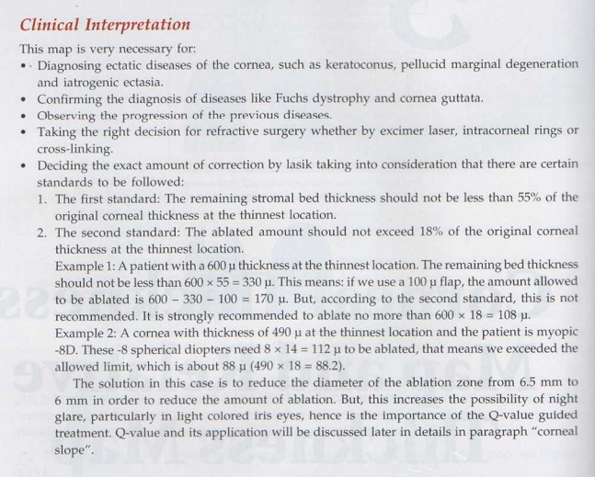
* Residual Stromal bed (RSB)
Role CT = 540um
Excimer laser *18% < 97um
RSB * 55% > 297 um
Ex. : patient CT= 540um, myopia= -5.00D
-1D = 14um of corneal will be cut by excimer laser with diameter of optical ablation zone = 6.5mm
* Amount corneal will cut by excimer laser
5 x 14 um = 70 um
* Post-Op Residual Stromal Bed
RSB = 540um – 130um (lasik flap) – 70um = 340um
Notes:
Patient 490 , -8.00D
-1D = 14um of cornea will be cut
8 x 14 = 112um
The amount allowed for cut = 490 x 18% =88.2 um
>> solve this problem by > reduce the diameter of the ablation zone form 6.5mm to 6mm

Slide 31
Risk Assessment for Ectasia after
Corneal Refractive Surgery
  RSB = 340um
  CT = 540um
  MRSE = - 5.ooD
J. Bradley Randleman et al. Ophthalmology 2008
Pattern | SCORE
 | 4 | 3 | 2 | 1 | 0
Topography | Abnormal topography | Inferior Steepening / Skewed radial axis | Asymmetric bow tie | Asymmetric bow tie | Normal / Symmetric bow tie
RSB | < 240 µm | 240 – 259 µm | 260 - 279 µm | 280-299 µm | ≥ 300 µm
Age | <18yrs | 18 – 21 yrs | 22 - 25 yrs | 26 - 29 yrs | ≥ 30 yrs
CT | < 450 µm | 451 – 480 µm | 481 - 510 µm | ≥ 510 µm | ≥ 510 µm
MRSE | > -14.00 | > -12.00 to -14.00 | > -10.00 to -12.00 | > -8.00 to -10.00 | -8.00 or less
The final score is almost 0 to 1,
the relative risk is low and we can proceed with Lasik.

Slide 32
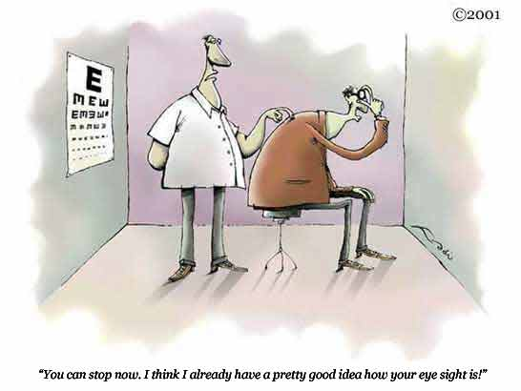
Thank you for your attention but my slide presentation is behind you :-)

Slide 34
Patient Consent Form
Patient‘s expectation
Patient should understand :
Risk,
- Glare and halo post-op
- Under and over-correction
Benefit,
- Outcome guarantee
- No glasses, till another ocular disease develops
Alternative of LASIK procedure
- Mono-vision correction / Laser Blended Vision
- Refractive Lens Exchange
- Intraocular Contact Lens (ICL)
- PRK

Slide 35
Patient Investigation
Slit Lamp
Final refraction test
ORB scan / cornea Topo
Abberrometer ?
Anterior Segment OCT ?
Schimers test
Cyclo Refraction = 3 dilated AR
Fundus – if require prophylactic laser
Systemic disease – Lab investigation ( suspected )

Slide 36
The correct decision for refractive surgery depends to a great extent on
The right eye exam
And the right topography
There are many factors affect the validity and accuracy of corneal topography.

Slide 37
Anatomy
Type of laser , lasik prk
  Intralase ( femto sencond laser)
  ( icl ) , prebyopia (monovision , laser blended vison, distance vs near ), lens exchangce
Laser blended vision - Laser Blended Vision can be achieved through laser eye surgery, usually performed as LASIK, although surface laser eye surgery PRK or LASEK can be used to produce the effect. Laser Blended Vision works by increasing the depth of field of each eye through subtle changes in the optics of the cornealspherical aberration.^{[2]} The increase in depth of field allows for the eyes to be corrected in such a way that the dominant eye is set for distance and intermediate vision while the non-dominant eye sees best in the intermediate to near range. Because of the similarity in the visual performance of each eye in the intermediate range the brain is able to fuse the images between the eyes rendering a binocular visual environment.
This is in contradistiction to traditional monovision where the image disparity between the eyes is too high for image fusion by the brain and instead the brain needs to apply suppression of the blurred eye in order to perceive a clear visual field. In Laser Blended Vision, the eyes are effectively working together to allow good vision at near, intermediate and far, without the use of glasses. The effects of Laser Blended Vision tend to last between 5 and 10 years but can be further adjusted by enhancement procedures.
Type of who should do it
Instrument for musure cornea surface
Pattern of corneal curvature
  Normal cornea
Notes:
Taking the right decision in laser refractive surgery depends to a great extent on good reading of corneal topography and its clinical interpretation. This is very important for having the aimed result and avoiding post-operative complication.

Slide 38
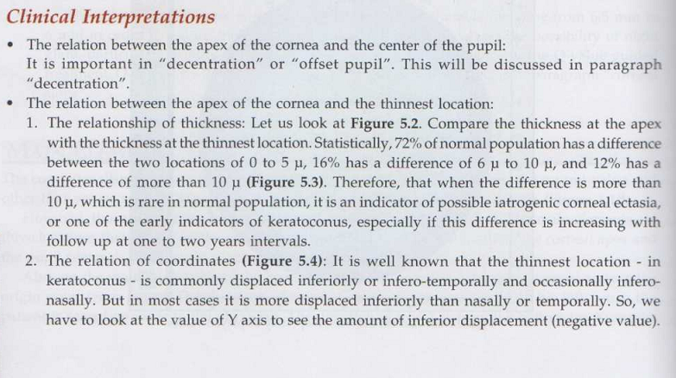
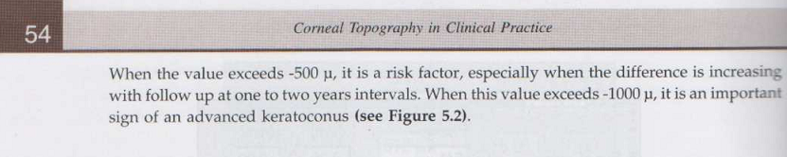
Notes:
0-5um = 72 %
6-10um = 16%
10um =12 % early indictor of keratoconous
Inferoir > inferoir temperal > inferoir nasal
Look at Y axis to see inferior displace ( Negative value, if > -500um , high risk. If > -1000um, sign of advanced keratoconous)
0.1mm == 100um

Slide 39
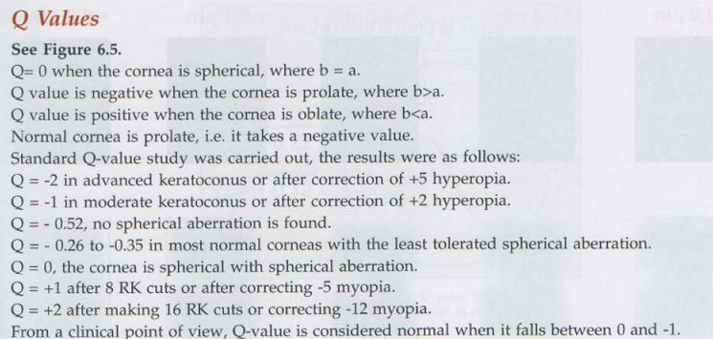
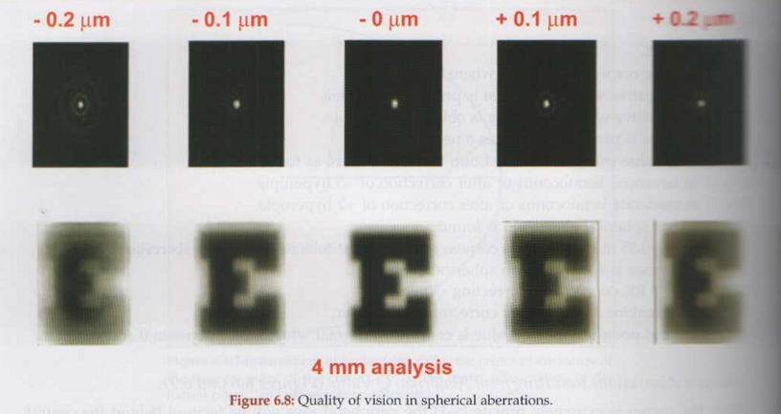

Slide 40
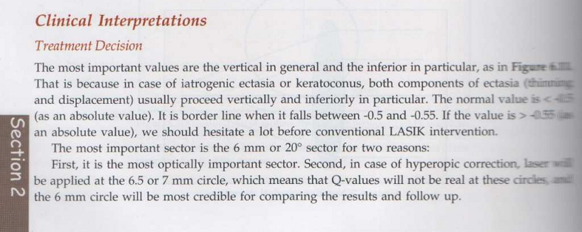

Slide 41
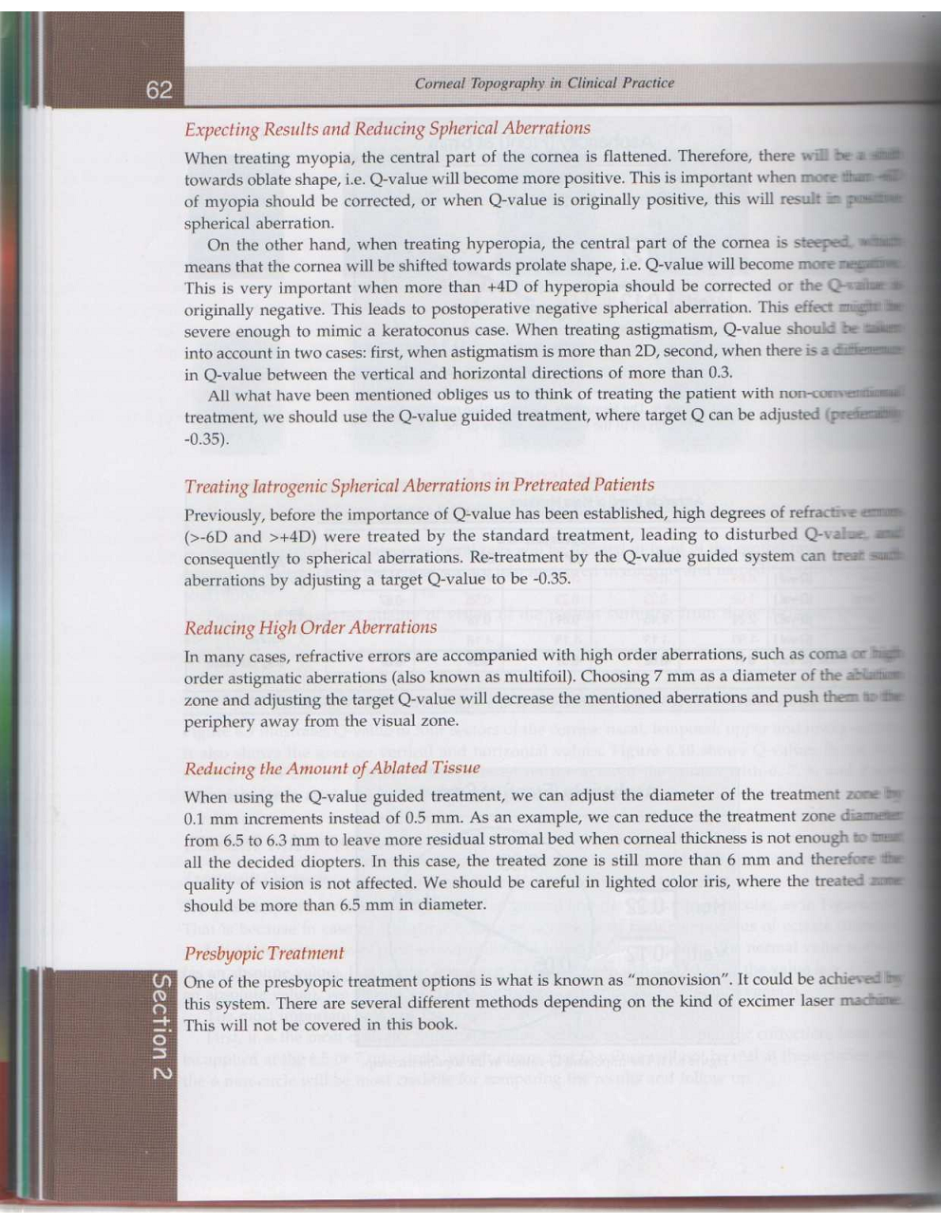

Slide 42
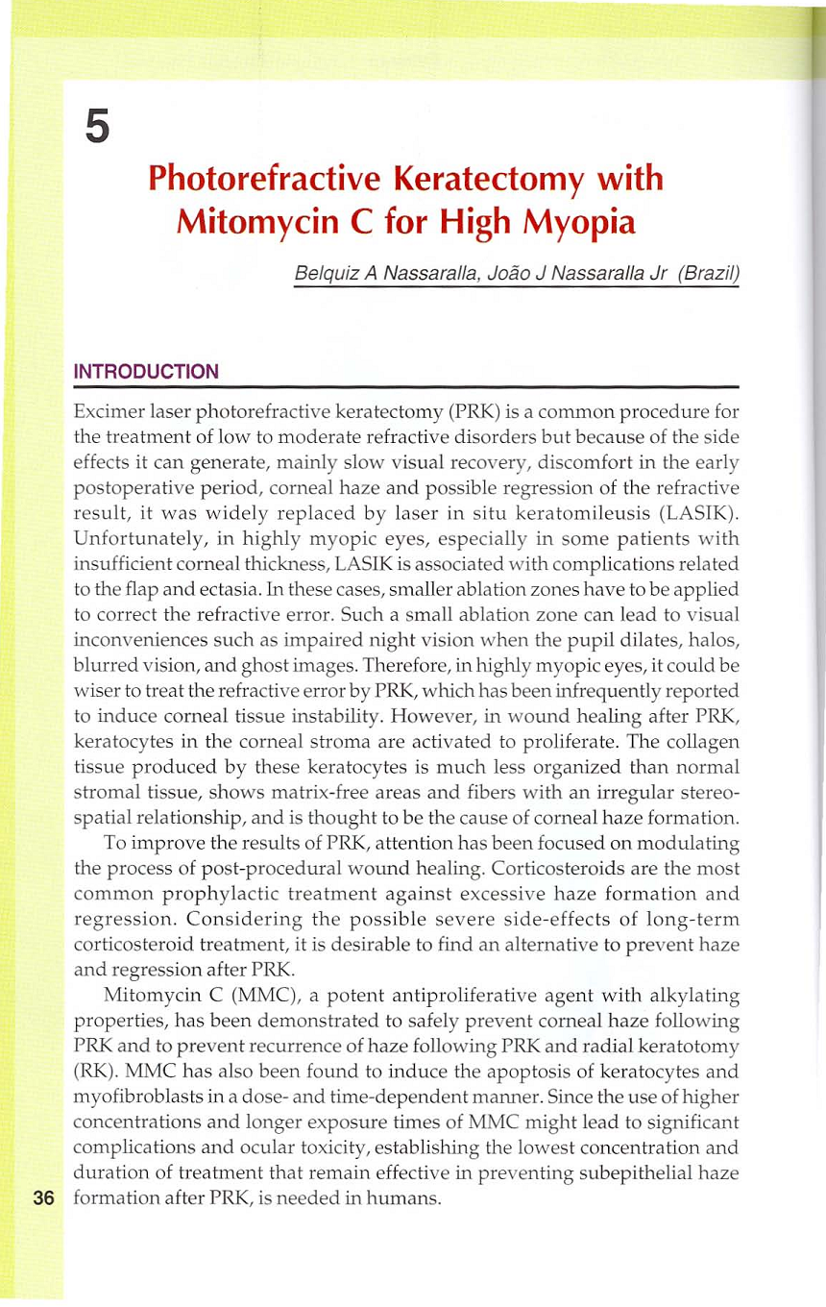

Slide 43
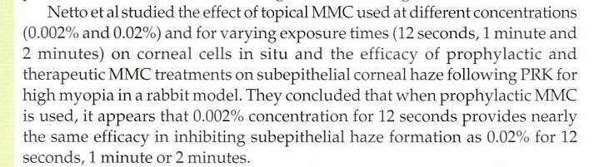

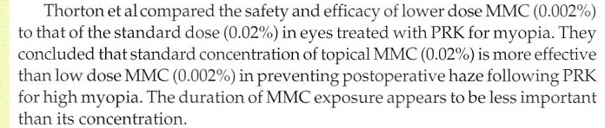
mmc

Slide 44
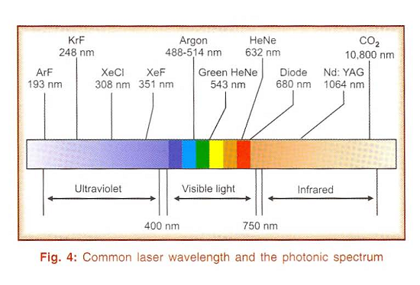
Notes:
Laser = light Amplification by Stimulated Emission of Radiation
The most typical excimer laser used in ophthalmology is ArF at 193nm wavelength
Nd:YAG laser = Neo-dymium yttrium aluminium garnet (1064nm, Max power 10w, Pulse mode 10nsec, spot size 1mm) – PCO , PI
Frequency-doubled Nd:YAG (532nm) – is used in place of argon laser for PRP

